Slide 1

Vrinda Store
Data Analysis Project
Using

Slide 2
objective
This Project Goal is to examine to Vrinda Store Sales data in order to produce an annual sales report of 2022. To Better Understand their clients and to increase sales in 2023.
Which month got the highest sales and orders?
Who purchased more men or women in 2022?
What are the different order status in 2022?
What are the top 10 states that contribute the sales?
What are the most popular categories?
Which marketing channel is generating the most revenue?

Slide 3
During the process of building this dashboard is have done various Techniques.
Data Cleansing, analysis and Filtering
Basic formulas of excel
Establishing pivot tables.
Designing the dashboard with formatting options
Inserted the slicers for each pivot table

Slide 4
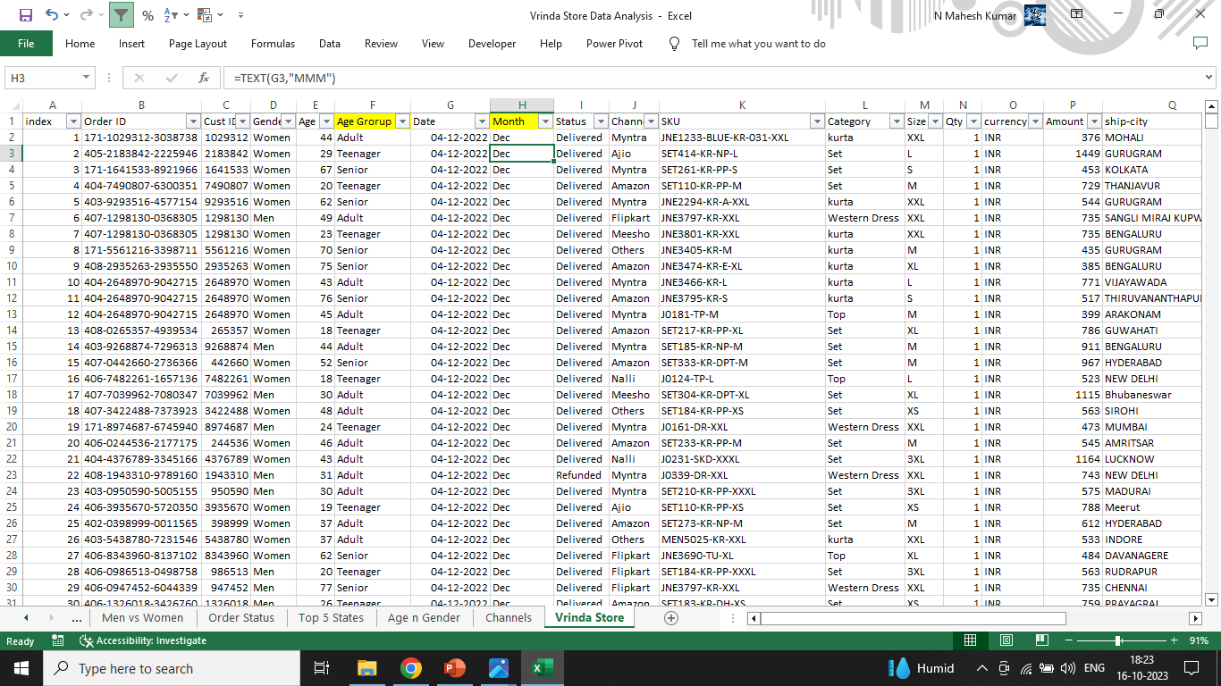
Data Processing

Slide 5
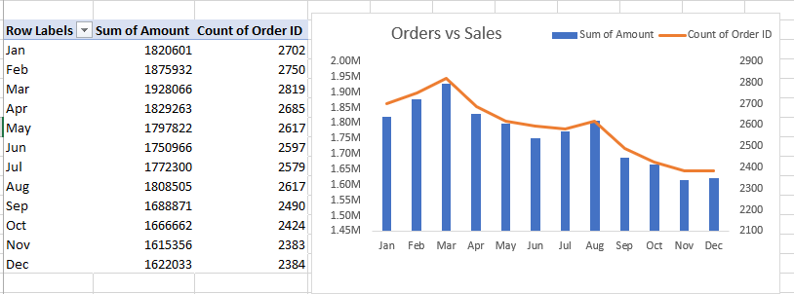
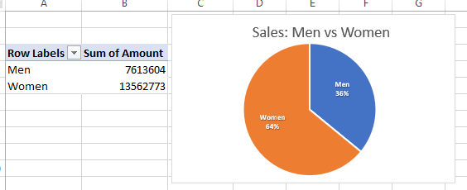
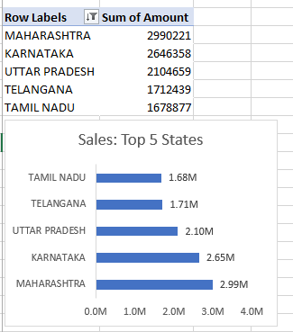
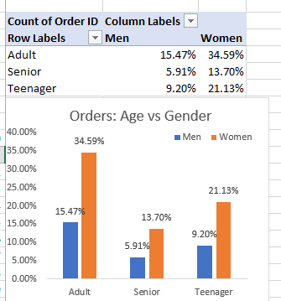
Pivot charts

Slide 6
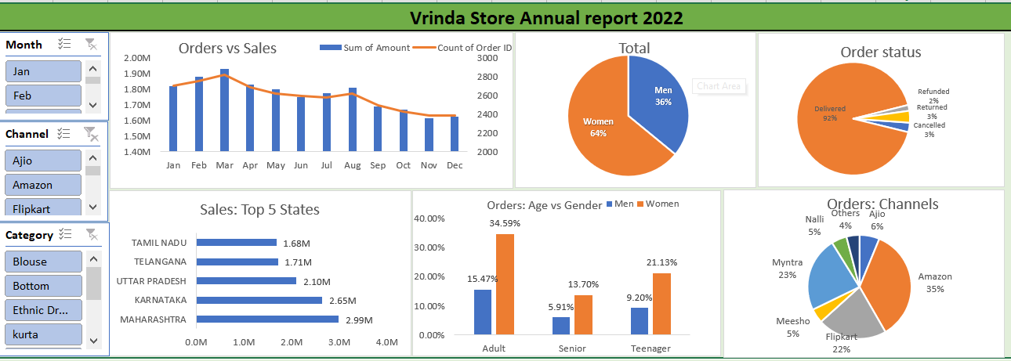
Final Dashboard

Slide 7
Project Insights
Women are more likely to buy as compared to men.
Maharashtra, Karnataka, and Uttar Pradesh are top 3 states
Amazon, Myntra and Flipkart channels are max Contributing.
Adult age Group (30-40 yrs) is max contributing
Final conclusion to Improve Vrinda Stores Sales:
Target women customers of age group (30-40 yrs) living in Maharashtra, Karnataka and Uttar Pradesh by showing ads/offers/coupons available on amazon, Flipkart and Myntra.

